Slide 1
NTI • ADVANCED DATA ANALYSIS • BATCH 9
Healthcare Test Results
Prediction
A classification system that predicts a patient's initial test result
(Normal / Abnormal / Inconclusive) at the moment of admission.
PREPARED BY
Instructor: Eng. Huda Hemdan
Youssef Kromal
Mohamed Hossam
Alhassan Mohamed
Mahmoud Mohamed
Mohamed Farouk
Final Project — Advanced Data Analysis

Slide 2
ROADMAP
What We'll Cover
1
Project Overview
Objective, success criteria & the business questions we set out to answer
55,000+
2
Dashboard Insights
Hospital Admissions
Power BI view of 55K admissions across patients, conditions & billing
Exploratory Analysis
3
3
Testing whether condition, admission type, age or insurer drive outcomes
Test Result Classes
4
Predictive Model
Building & comparing classifiers to predict the test result at admission
38.5%
5
Results & Recommendations
Best Model Accuracy
What the model tells us — and what hospital staff should do with it
Healthcare Test Results Prediction | NTI Batch 9
2

Slide 3
PROJECT OVERVIEW
From Raw Admissions Data to a Prediction Model
Healthcare organizations generate large volumes of patient and admission data. Analyzing it can reveal patterns in patient characteristics and test outcomes — patterns that, if predictable, could help hospital staff triage incoming patients more effectively.
SUCCESS CRITERIA
Business KPI
Improved prioritization of medical review for incoming patients.
BUSINESS OBJECTIVE
Technical Metric
Build a classification system that predicts a patient's initial Test Result (Normal / Abnormal / Inconclusive) at admission time — using only data available at check-in — to help staff prioritize medical follow-up.
Classification accuracy above the random baseline of 33.3% (3 balanced classes).
Target Variable
Test Results — Normal, Abnormal, or Inconclusive.
Healthcare Test Results Prediction | NTI Batch 9
3

Slide 4
FRAMING THE ANALYSIS
Five Business Questions
1
Is there a relationship between Medical Condition and Test Results?
2
Does Admission Type (Urgent / Emergency / Elective) affect the test outcome?
3
Is Age a significant factor in the test outcome?
4
Do Insurance Provider or Hospital show any distributional bias in outcomes?
5
Which classification model best predicts Test Results?
Healthcare Test Results Prediction | NTI Batch 9
4

Slide 5
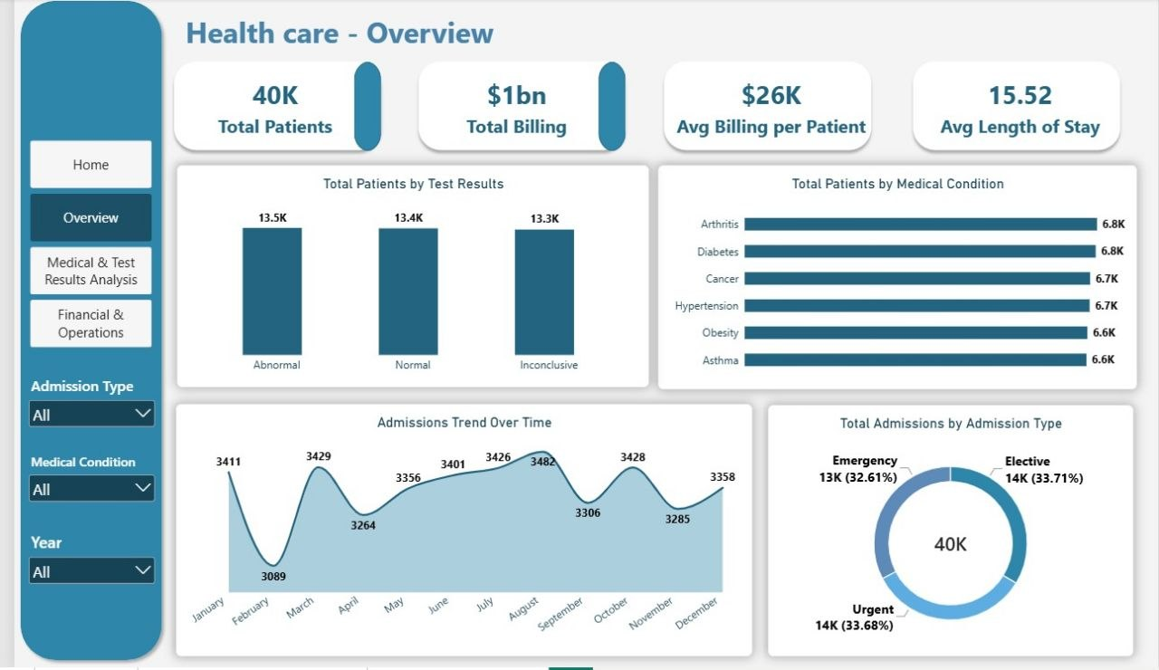
POWER BI DASHBOARD
Overview: Admissions at a Glance
40K patients · $1bn total billing · $26K avg. billing per patient · 15.52 days avg. length of stay
Healthcare Test Results Prediction | NTI Batch 9
5

Slide 6
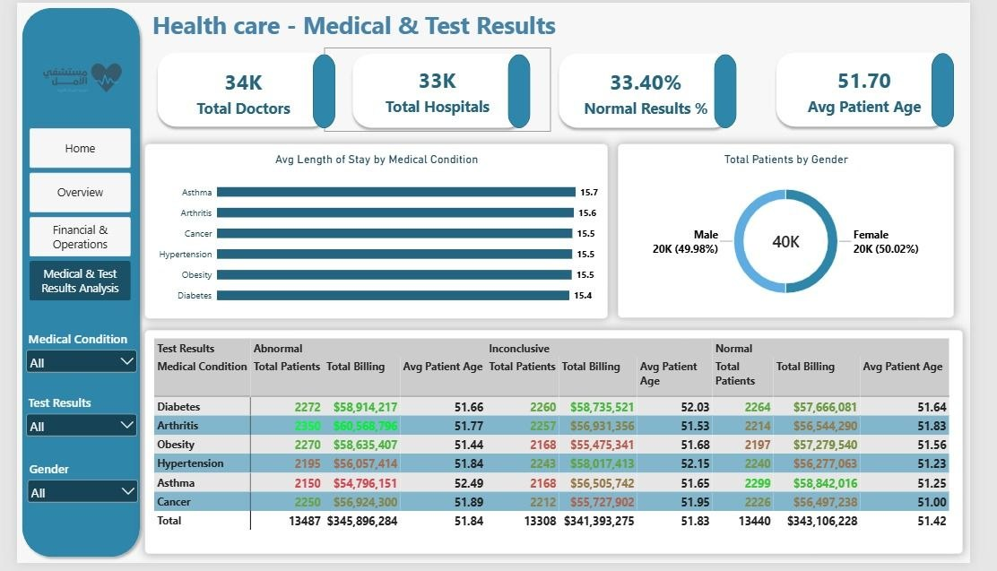
POWER BI DASHBOARD
Medical & Test Results Analysis
34K doctors · 33K hospitals · 33.4% of results come back Normal · avg. patient age 51.7
Healthcare Test Results Prediction | NTI Batch 9
6

Slide 7
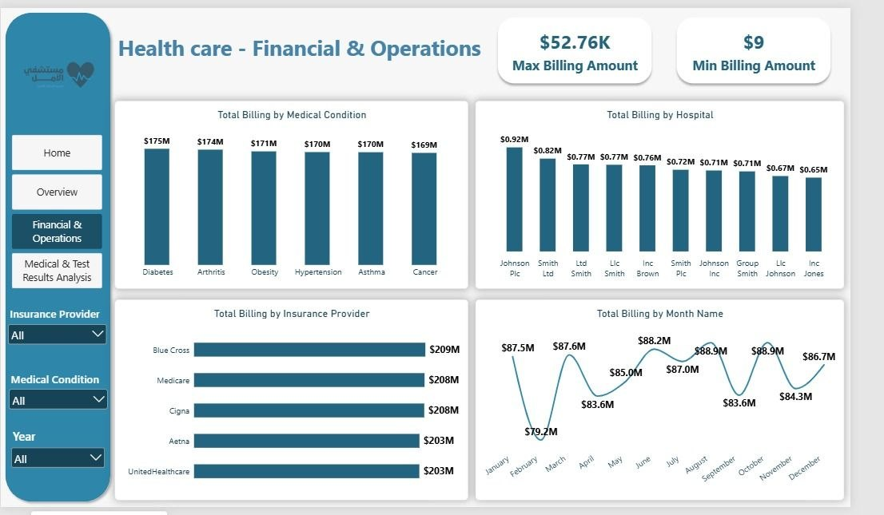
POWER BI DASHBOARD
Financial & Operations
Billing is broken down by condition, hospital, insurer and month — max single bill $52.76K, min $9
Healthcare Test Results Prediction | NTI Batch 9
7

Slide 8
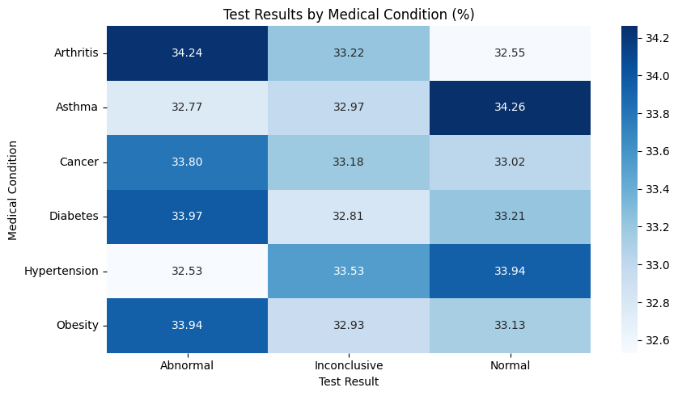
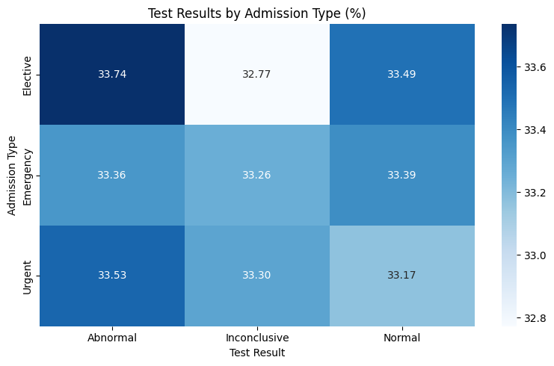
EXPLORATORY ANALYSIS · Q1 & Q2
Condition & Admission Type Barely Move the Needle
Q1 · Medical Condition
Q2 · Admission Type
Share of Abnormal results by condition (%)
Result distribution by admission type (%)
Healthcare Test Results Prediction | NTI Batch 9
8

Slide 9
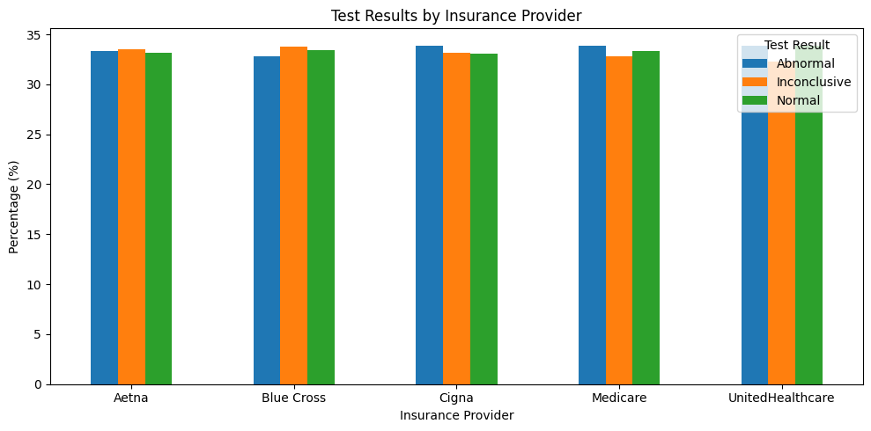
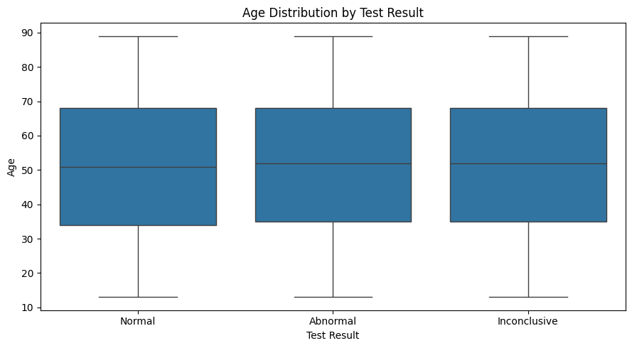
EXPLORATORY ANALYSIS · Q3 & Q4
Age and Payer Show No Real Bias Either
Q3 · Patient Age
Q4 · Insurance & Hospital
Average age by test result
Abnormal-result rate by insurer (%)
51.31
51.64
51.66
Normal Abnormal
Inconclusive
Population-level: insurer range is just 1.1 points. Small top-10 hospitals show wider swings, but each has only 32–44 records — too few to trust.
Under half a year apart across all three groups — age isn't a differentiator.
Healthcare Test Results Prediction | NTI Batch 9
9

Slide 10
BUSINESS QUESTION 5
Building the Prediction Pipeline
1
2
3
4
Features
Preprocessing
Train / Test Split
Models Trained
Age, Gender, Blood Type, Medical Condition,
Insurance Provider, Admission Type, Medication
→
One-Hot Encoding for 6 categorical features
+ the numeric Age column
→
80 / 20 stratified split
43,972 training · 10,994 testing rows
→
Baseline (most-frequent class)
Random Forest · Support Vector Machine (RBF)
Random baseline for 3 balanced classes = 33.3% — that's the bar every real model has to clear.
Healthcare Test Results Prediction | NTI Batch 9
10

Slide 11
MODEL COMPARISON
Random Forest Comes Out Ahead
BEST MODEL
Random Forest
38.49%
+5.2 points over the 33.3% baseline. SVM (33.24%) essentially matched the baseline — no better than guessing.
Healthcare Test Results Prediction | NTI Batch 9
11

Slide 12
MODEL EVALUATION
How the Random Forest Performs, Class by Class
Class | Precision | Recall | F1-score | Support
Normal | 0.38 | 0.39 | 0.38 | 3,666
Abnormal | 0.38 | 0.39 | 0.39 | 3,688
Inconclusive | 0.39 | 0.38 | 0.38 | 3,640
Weighted Avg | 0.38 | 0.38 | 0.38 | 10,994
READING THE CONFUSION MATRIX
The model spreads its errors evenly across all three classes — it isn't collapsing toward one label. That confirms the accuracy gain over baseline is real signal, not a shortcut like “always predict Normal.”
Precision, recall and F1 hover around 0.38–0.39 for every class — balanced, but not strong.
In short: the available admission-time fields carry a weak but genuine signal — enough to beat guessing, not enough for high-confidence clinical decisions on their own.
Healthcare Test Results Prediction | NTI Batch 9
12

Slide 13
IN ACTION
Predicting a New Patient's Test Result
SAMPLE PATIENT AT ADMISSION
MODEL PREDICTION
Age
45
Inconclusive
Gender
Female
Inconclusive
42.00%
Blood Type
A+
Medical Condition
Diabetes
Abnormal
38.67%
Insurance
Aetna
Admission Type
Urgent
Normal
19.33%
Medication
Aspirin
Healthcare Test Results Prediction | NTI Batch 9
13

Slide 14
WRAPPING UP
Conclusions & Recommendations
KEY FINDINGS
RECOMMENDATIONS
Medical condition, admission type, insurer and hospital show no meaningful relationship with test outcome at the population level — all sit within ~1–2 points of the 33.3% baseline.
Deploy Random Forest as a lightweight triage assist, not a stand-alone diagnostic tool.
Age is not a differentiator: average age is within half a year across Normal, Abnormal and Inconclusive results.
Enrich the feature set with clinical signals (vitals, prior labs, symptoms) — the current admin-only fields cap accuracy near 38%.
Random Forest is the strongest model (38.49%) and clears the technical success criterion, but the lift over baseline is modest.
Re-evaluate Insurance/Hospital bias once more admissions per hospital are available — today's top-10 samples are too small (32–44 records) to confirm.
SVM performed no better than guessing (33.24%) — not a viable choice for this feature set.
Monitor class-wise precision/recall in production to catch drift across Normal / Abnormal / Inconclusive.
Healthcare Test Results Prediction | NTI Batch 9
14

Slide 15
Thank You
Questions & discussion welcome.
Healthcare Test Results Prediction · NTI Batch 9 · Instructor: Eng. Huda Hemdan

